Slide 1
We’re the Verification Specialists
Verifi1
Verification is Complicated.
We’ve Simplified the Process.

Slide 2
Who We Are
We’re the Verification Specialists.
We customize the verification process to help companies of all sizes maximize their healthcare spend.
Our team has over 15 years of experience working with countless Fortune 500 companies.
We understand the unique verification needs from business to business and are continually evolving to ensure those needs are being well taken care of.

Slide 3
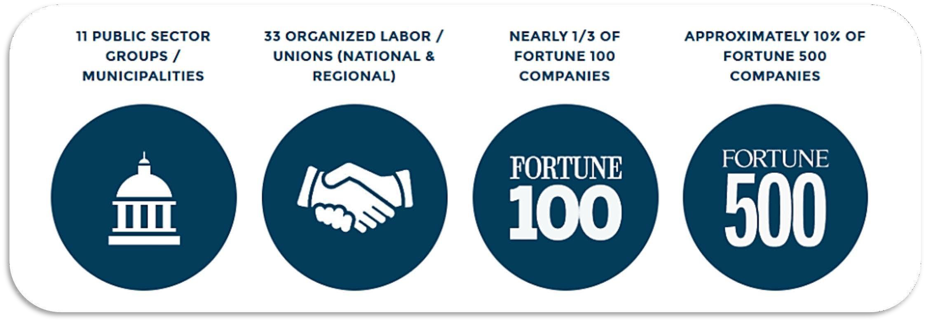
Our Experience

Slide 4
What We Do
Risk Mitigation Solutions and Advanced Document Analysis
We specialize in a wide range of eligibility applications and risk mitigation services including:
Dependent Eligibility Verification
Life Event Reviews
PPACA Reporting Services
Claims Auditing Assistance*
* through Verifi1 partner

Slide 5
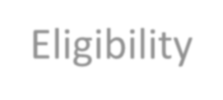
Our Services
Dependent Eligibility Verification
Identifying ineligible dependents
listed on corporate sponsored health
insurance plans resulting in significant
savings and risk avoidance involving unbudgeted benefits expenditures.
Life Event Reviews
Implementing a sophisticated system
employers can utilize to validate,
track, and report life event changes
involving employees attempting to
onboard dependents outside of their standard annual enrollment period.
Claims Auditing Assistance
Through Verifi1’s claims auditing partner, clients can receive access to an industry leading state-of-the-art platform coupled with preferred/discounted pricing.
Dependents’
Eligibility

Slide 6
How It Works
Verification is complicated. Verifi1 has simplified the process.
Our comprehensive 4-step approach - as illustrated below for our flagship dependent eligibility verification service - ensures success from beginning to end.
Use Summary Plan Description (SPD) information to establish eligibility rules and determine what types of documents are required to verify dependent eligibility.
Communication is vital to employee participation in dependent eligibility verification. We create customized communication campaigns based on each company’s specific needs and culture. Our outreach to employees consists of notification, education, reminder, and results interactions throughout the initiative coupled with easy access to a state-of-the-art web portal.
Conduct Ongoing Verification
Manage collection of documents for the verification process to make it easy for employees to submit via scan, upload, fax, and mail.
Our automated system - backed with the most advanced OCR technology and further supported by highly skilled auditors - then processes scanned data and verifies eligibility as set by your eligibility rules.
Dependent eligibility
verification is an ongoing issue. The percentage of new hires with ineligible dependents often times exceeds what transpired with the initial employee screening, so we suggest conducting ongoing
dependent eligibility verification on a regular basis. We conduct verification reviews for all new hires, as well as
employees who have made a change to their dependent status during the previous enrollment year.

Slide 7
The Verifi1 Advantage
Verifi1 Competition
Customizable Reporting YES LIMITED
High volume client onboarding YES NO
Upload Documents Online YES LIMITED
Fully Supported Contact Center YES LIMITED
24/7 Interactive Voice Response System YES NO
Customizable Consultant interface YES NO
Ongoing Verification Services YES LIMITED
State-of-the-art platform YES LIMITED
Professional/interactive website YES NO
Life Event Change Interface YES NO
Best in Class Verification Services Pricing YES NO
Custom Pre-verification Communications YES NO
U.S. based contact center/IT resources YES LIMITED
Outbound calling/texting services YES LIMITED

Slide 8
Experience The Verifi1 Difference
We make it easy!
For the Employer:
We do all the work! Customized communications Custom employer portal
For the Employee:
We assist every step of the way
Takes less than 5 minutes to complete veriﬁcation!
Custom employee portal

Slide 9
Verifi1 "TRUST...but verify"
WWW.VERIFI1.COM
26533 EVERGREEN ROAD SUITE 400
SOUTHFIELD, MICHIGAN 48076
8

