Slide 1

Quality of Life…Insurance SelectChoice II
Accelerated Benefit Riders
Presented by…
Trevor Keeble
Director of Product Training
Policies issued by American General Life Insurance Company ("AGL“)
Notes:
The new Quality of Life…Insurance SelectChoice II Accelerated Benefit Riders provide a great value proposition to your clients and prospects. This presentation will walk through the details of the new riders and explain how they work.

Slide 2
Value of Living Benefits
Help cover cost of care for chronic, critical, or terminal illness
Provide peace of mind during a difficult time
Help maintain quality of life
On ALL Quality of Life…Insurance Products
NO ADDITIONAL PREMIUM COST
Notes:
Living benefits are quite valuable and an important aspect in today’s financial planning. Not having the proper coverage in place to help protect against the unknown can derail even the most sound financial plans.
Living benefits will help cover the cost of care for chronic, critical, or terminal illnesses.
They provide peace of mind to your clients during a difficult time. Knowing they can accelerate a portion of their life insurance policy’s death benefit can help ease the financial burden caused by these unexpected illnesses or conditions.
It will also help your clients maintain their quality of life.
The SelectChoice II Accelerated Benefit Riders are included automatically on all Quality of Life…Insurance products. There are no underwriting restrictions. If they qualify for the policy, they automatically receive the accelerated benefit riders on their policy.
The best part is that these valuable benefits are provided on the policy at no additional premium cost to the client.

Slide 3
Accelerated Benefit Rider Details
Accelerate 100% of death benefit, up to $2 million, for a qualifying chronic, critical, or terminal illness
Total accelerated death benefit across all QoL policies may not exceed $2 million
Provide a discounted benefit depending on severity of the condition and the expected impact on life expectancy
  More severe the expected impact on life expectancy, greater the accelerated amount
  Death benefit will be reduced by full claimed amount
Now includes GUARANTEED MINIMUM benefit payout
  Percentage of death benefit based off policy year at time of claim
Indemnity Benefit—No receipts required; spend benefits on anything
Notes:
These riders allow the client to accelerate 100% of their death benefit, up to $2 million, for a qualifying chronic, critical, or terminal illness.
The total accelerated death benefit across all QoL policies may not exceed $2 million.
The riders provide a discounted benefit to your client depending on the severity of the condition and the expected impact it has on their remaining life expectancy. Because they are receiving a portion of their death benefit early, the actual amount they receive is discounted to account for the early acceleration. The more severe the expected impact on life expectancy, the greater the accelerated amount they receive may be. The policy’s death benefit will be reduced by the full claimed amount.
This version of the accelerated benefit riders now includes a guaranteed minimum benefit payout for the chronic, critical, and terminal illness conditions. The guaranteed minimums are a percentage of the policy’s death benefit and are based off the policy year at the time a claim is made.
The SelectChoice II accelerated benefit riders are an indemnity type of benefit. That means the client does not have to provide receipts to receive the acceleration or wait to be reimbursed for their medical expenses. In fact, they can spend the benefit payout on whatever they see fit.

Slide 4
Chronic Illness
Permanency Requirement Removed!
An illness or physical condition that:
Certified in the last 12 months by a licensed health care practitioner
AND
Affects the insured so that he or she is unable to perform without substantial assistance at least 2 activities of daily living
OR
Requires substantial supervision by another person to protect themselves from threats to health and safety due to severe cognitive impairment
Activities of Daily Living
Bathing
Eating
Dressing
Toileting
Transferring
Continence
Notes:
Lets take a look at the chronic illness benefit. A chronic illness is defined as:
An illness or physical condition that:
Is certified in the last 12 months by a licensed health care practitioner
AND
Affects the insured so that he or she is unable to perform without substantial assistance at least 2 activities of daily living
OR
Requires substantial supervision by another person to protect themselves from threats to health and safety due to sever cognitive impairment.
The activities of daily living are: Bathing, eating, dressing, toileting, transferring, and continence.
Finally, we have removed the permanency requirement for the chronic illness benefit. That means the insured’s chronic illness is no longer required to remain permanent in order to receive the acceleration. They can now be expected to recover from the condition and still receive the benefit as long as they meet the other criteria.

Slide 5
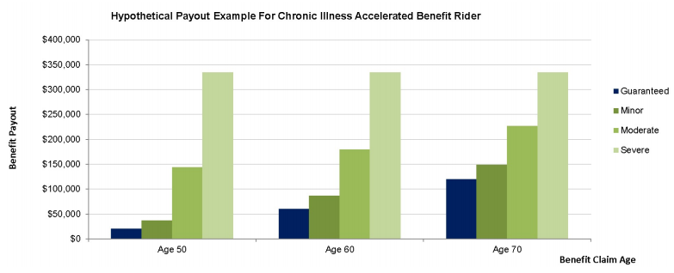
New Illustration Graphs-Chronic Illness
The hypothetical example shown assumes that the policy is issued with a life insurance benefit of $500,000 on a male, age 45, Standard Non Tobacco. Hypothetical amounts shown assume that no policy premiums are unpaid and that there is no loan balance. The potential benefit payouts were calculated using assumptions that are not guaranteed and may be changed at any time. Actual payouts may be more or less favorable.
Notes:
Our illustrations have been redesigned and now include new graphs that show hypothetical payout examples for the accelerated benefit riders.
Here you can see a graph that shows the guaranteed, minor, moderate, and severe payout examples for the specific scenario at different benefit claim ages.
The minor, moderate, and severe hypothetical payout examples are based off the company’s expected impact on the insured’s life expectancy. Remember, the greater the expected impact to their life expectancy, the greater the benefit payout.

Slide 6
Critical Illness
Qualifying Critical Illnesses
Major Heart Attack
Stroke
Coronary Artery Bypass
Invasive Cancer
Blood Cancers
End Stage Renal Failure
Major Organ Transplant
Paralysis
Coma
Severe Burn
An illness or physical condition that:
Insured is diagnosed by a physician within 365 days of date claim is received
Is diagnosed by a physician after insured’s coverage has been in force for 30 consecutive days (90 for invasive cancer)
Is not an occurrence of the same illness or condition that an acceleration has already been paid under this rider
Notes:
Next lets take a look at the critical illness benefit. A critical illness is defined as:
An illness or physical condition that:
The insured is diagnosed with by a physician within 365 days of the date the claim is received by the company.
Is diagnosed by a physician after the insured’s coverage has been in force for 30 consecutive days (or 90 consecutive days if the condition is invasive cancer).
And, is not an occurrence of the same illness or condition that an acceleration has already been paid under this rider.
The list of qualifying critical illnesses is:
Major Heart attack
Stroke
Coronary Artery Bypass
Invasive Cancer
End Stage Renal Failure
Major Organ Transplant
Paralysis
Coma
Severe Burn

Slide 7
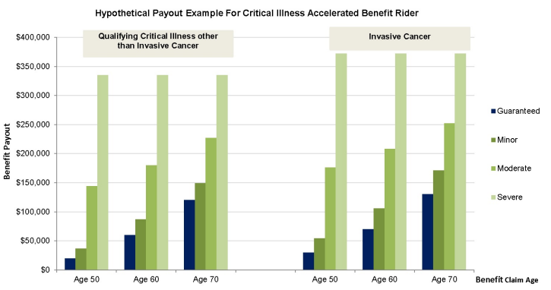
New Illustration Graphs-Critical Illness
*The hypothetical example shown assumes that the policy is issued with a life insurance benefit of $500,000 on a male, age 45, Standard Non Tobacco. Hypothetical amounts shown assume that no policy premiums are unpaid and that there is no loan balance. The potential benefit payouts were calculated using assumptions that are not guaranteed and may be changed at any time. Actual payouts may be more or less favorable.
Notes:
Here is a look at the graph and the chart that is shown on the illustration for critical illness.
Again, these are hypothetical payout examples that depict what the guaranteed payout would be and what the payout could be if the condition was considered minor, moderate, or severe.
You will notice that for critical illness there are 2 separate payout scenarios. One for invasive cancer and one for other qualifying critical illnesses that are not invasive cancer.
Because of the nature of the illnesses you can see that the hypothetical payouts are higher for invasive cancer than they are for the other critical illnesses.

Slide 8

Terminal Illness
An illness or physical condition that:
Is diagnosed by a physician to be reasonably expected to result in the insured’s death within 24 months from the date of the diagnosis
Notes:
The final portion of the accelerated benefit riders covers terminal illness. Terminal illness is defined as:
An illness or physical condition that:
Is diagnosed by a physician to be reasonably expected to result in the insured’s death within 24 months from the date of diagnosis

Slide 9
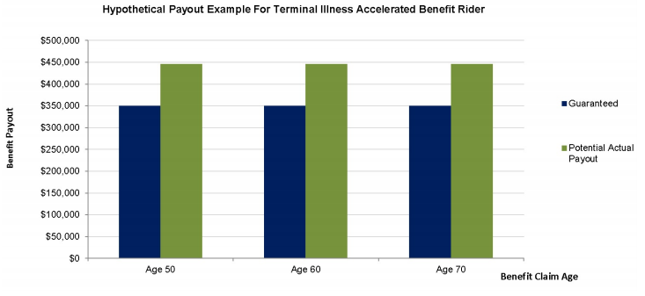
New Illustration Graphs-Terminal Illness
The hypothetical example shown assumes that the policy is issued with a life insurance benefit of $500,000 on a male, age 45, Standard Non Tobacco. Hypothetical amounts shown assume that no policy premiums are unpaid and that there is no loan balance. The potential benefit payouts were calculated using assumptions that are not guaranteed and may be changed at any time. Actual payouts may be more or less favorable.
Notes:
One thing you will notice that is different on the terminal illness graphs is that it shows only a guaranteed and a hypothetical life threatening payout. Because of the definition of a terminal illness it is not broken down by minor, moderate, or severe like the chronic and critical illnesses are.

Slide 10
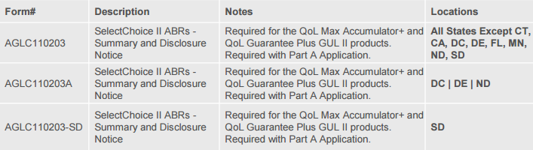
QoL ABR Disclosure Forms
New form required with Part A Application beginning November 30, 2016 and should be completed with the client at the time the application is taken.
The 1020 Life Kit has been updated and can be accessed via Forms Depot.
The QoL ABR Disclosure forms can also be downloaded from Forms Depot using the below Description or Form Number.

Slide 11
SelectChoice II Accelerated Benefit Riders
 | QoL SelectChoice II Accelerated Benefit Riders | LSW Accelerated Benefits Riders | ANICO Accelerated Benefits Riders | North American Accelerated Death Benefit Endorsement | Transamerica Trendsetter® LB Accelerated Death Benefits
Available Chassis | Term*, UL*, IUL, GUL | Term, IUL, UL | Term, IUL, UL, GUL | Guarantee UL, Indexed UL | Term Only
Guaranteed Minimum Payout | a |  |  | Critical illness 40%
Chronic Illness Maximum Acceleration | a Lesser of 100% of DB or $2,000,000 | a Lesser of 100% of DB or $1,500,000 | a $2,000,000 for 0-65 $1,000,000 for 66+ | a Lesser of 100% of DB or $1,000,000 | a Lesser of 90% of DB or $1,500,000
Critical Illness Maximum Acceleration | a Lesser of 100% of DB or $2,000,000 | a Lesser of 100% of DB or $1,000,000 | a $2,000,000 for 0-65 $1,000,000 for 66+ | a Lesser of 25% of DB or $50,000 Max Payout :$20,000 | a Lesser of 90% of DB or $1,500,000
Terminal Illness Maximum Acceleration | a Lesser of 100% of DB or $2,000,000 | a Lesser of 100% of DB or $1,500,000 | a $2,000,000 for 0-65 $1,000,000 for 66+ | a Lesser of 75% of DB or $750,000 | a Lesser of 100% of DB or $1,500,000
Waiting Period** | Chronic Illness: 30 day waiting period Critical Illness: 30 day waiting period | Chronic Illness: 2 year waiting period Critical Illness: 30 day waiting period | None | None | Chronic Illness: 2 year waiting period Critical Illness: 30 day waiting period
Available on all UW classes | a | Chronic illness: Up to Table D Critical Illness: No table rating | Chronic and Critical illness up to Table 4; not available with flat extra rating greater than $5.00 per thousand. | Chronic illness: Up to Table 4 Critical Illness: up to Table 2 | a - Term only
vs. LSW:
Higher Max Amount
Available on all UW
Shorter waiting period on Chronic
vs. ANICO:
Higher Max Amount for older ages
Available on all UW
vs. North American:
Better Critical Benefits
Higher Max Amount
Available on term
Available on all UW
vs. Trans:
Higher Max Amount
Available on all QoL products
Shorter waiting period on Chronic
As of 6/9//2016.
Riders may be subject to state variations *New rider not available on QOL Flex Term or QOL Performer Plus
Notes:
Quality of Life . . . SelectChoice II Accelerated Benefit Rider provides real benefits and real flexibility to your clients, which means real protection they need. In this grid, you can see how the SelectChoice II Accelerated Benefit Rider stacks up against the competition.
Read From Slide.

Slide 12

Accelerated Access Solution (AAS)
Additional Chronic Illness Coverage
Policies issued by American General Life Insurance Company ("AGL“)
Notes:
The new Quality of Life…Insurance SelectChoice II Accelerated Benefit Riders provide a great value proposition to your clients and prospects. This presentation will walk through the details of the new riders and explain how they work.

Slide 13
Accelerated Access Solution Details
Additional paid Chronic Illness benefit available on new QoL products
Accelerate 100% of death benefit, up to $3 million, in the event of qualifying chronic illness
Dollar-for-dollar acceleration; client always knows the benefit amount
Maximum underwriting class: Table D
Minimum monthly benefit payout: $1,000
Benefit payout may be elected to be lump sum or monthly payout
Notes:
Read through slide

Slide 14
Accelerated Access Solution
101(g)
No LTC license necessary
2-out-of-6 ADLs; or Severe Cognitive Impairment
No Longer Required to be Permanent*
Indemnity Benefit
No Receipts
Spend benefits on anything
Flexible Benefit Base
Benefit = 50% up to 100% of Death Benefit
$50,000 minimum up to $3,000,000 maximum
Full waiver of monthly deductions
  *Connecticut Chronic Illness Accelerated Death Benefit Rider Requirements (15600-7)
  Chronic Illness in the state of Connecticut is defined as the insured being certified, within the previous12 months, as suffering a medically determinable condition which results in their being considered unable to perform 2 of 6 Activities of Daily Living, or requiring substantial supervision. Further, as a result of this condition, the insured must have been confined for at least six months in their place of residence or in an institution that provides necessary care or treatment of an injury, illness or loss of functional capacity. Finally, it must have been medically determined that the insured person is expected to remain confined in such place of residence or institution until death.
Notes:
14
Let’s look at some of the benefits of the Accelerated Access Solution.
Accelerated Access was filed as a rider under IRC section 101(g). That primarily means that:
No LTC license is required for you to be able to sell the Accelerated Access Solution as part of an AG Secure Lifetime GUL II policy. Your Life Insurance and Accident & Health licensing is all that’s necessary from a licensing standpoint.
It also means that the primary triggers for Chronic Illness benefits are either (1) inability to perform 2-out-of-6 Activities of Daily Living (ADL’s); or (2) severe cognitive impairment.
The benefit was filed as an Indemnity benefit. That’s completely different than the alternative – the Reimbursement benefit. With Reimbursement, you must file a claim and provide copies of all invoices. Your claim is reviewed and, eventually, you receive a reimbursement in an amount the insurance company deems appropriate based on your receipts. With American General Life’s Indemnity version, you don’t need to provide an receipts or file any claims regarding your treatments. American General Life will send your benefit checks every month, regardless of whether you’ve incurred any costs at all, and regardless of what those costs were. You meet the criteria for ADLs or severe cognitive impairment, file your claim and satisfy the 90-day waiting period, and American General Life begins sending the checks.

Slide 15
Accelerated Access Solution (AAS)
Flexible Monthly Benefit
IRS Per Diem capped at 2% per month
IRS Per Diem capped at 4% per month
IRS Per Diem with No Cap!
  Max. Monthly Benefit = Total Benefit ÷ 12 months
  The 8.3% Option!
IRS caps the maximum daily rate each year. The 2017 maximum is $360/day or $10,950/month. Subsequent years may be higher.
Notes:
15
Monthly benefit: American General Life will always pay up to the maximum IRS monthly Per Diem benefit, but you have a choice of three different caps on the maximum monthly benefit American General Life will pay.
2% of the AAS Benefit Base. With this option, if you had an Accelerated Access Solution aggregate benefit of $500,000, your monthly maximum benefit would be the lesser of: (a) the IRS monthly Per Diem; or (b) $10,000 per month.
4% of the AAS Benefit Base. With this option, if you had an Accelerated Access Solution aggregate benefit of $500,000, your monthly maximum benefit would be the lesser of: (a) the IRS monthly Per Diem; or (b) $20,000 per month.
If you don’t choose to cap your monthly benefit at 2% or 4%, and assuming the same aggregate $500,000 Accelerated Access Solution benefit, the maximum monthly benefit will be the lesser of: (a) the IRS monthly Per Diem; or (b) $500,000 divided by 12 months = $41,666 per month.
So, choose your aggregate benefit, and your monthly cap, and you’ll be ready to go!

Slide 16
Benefits of Accelerated Access Solution
Inflation hedge against future costs
Purchase more than today’s Per Diem limit
  Many products won’t allow it
  Provides inflation protection with a maximum monthly benefit cap
4% Cap – example:
  4% of $300,000 = $12,000 per month
  Go on-claim in 2017: Collect $10,950 per month
  Go on-claim in the future when Per Diem = $15,000 per month: Collect $12,000 per month
Per Diem – example:
  $300,000 AAS benefit
  Maximum monthly benefit: $300,000 = $15,000 per month
Notes:
16
For clarification, here are a few more examples.
With Accelerated Access Solution you can actually purchase more than today’s Per Diem limit.
There are products on the market that won’t let you purchase a benefit in excess of the current year’s Per Diem limit, which means your benefit will never go up, regardless of an increasing, inflation adjusted Per Diem.
Because AIG allows you to purchase an aggregate amount and a monthly benefit amount in excess of the current Per Diem, the outcome is very simple. At lower Per Diem amounts you get less per month, but for more months. At higher Per Diem amounts you get more per month, but for fewer months.
Let’s look at another example using a 4% cap. If you purchased a $300,000 Accelerated Access Solution benefit, your maximum monthly benefit would be $12,000. Accelerating $12,000 per month would be able to continue for 25 months ($300,000 ÷ 12 = $25)
If you went on-claim in 2014 you’ wouldn’t receive the entire $12,000 per month. The IRS Per Diem would limit you to $9,900 per month, which would last for 30 months.
And, if you went on claim when the IRS Per Diem was $15,000, American General would limit your monthly benefit to your capped amount of $12,000 per month.
Lastly, if you did not choose a 2% or 4% cap, then your maximum monthly benefit is your total benefit divided by 12. In this example, $300,000 ÷ 12 = $25,000 per month.
Naturally, if the Per Diem amount is less than $25,000 per month, you’ll receive the Per Diem in effect when you began your claim.

Slide 17
Coordination of Benefits
AAS benefit pays out first in event of Chronic Illness (100% of DB up to $3 million)
Critical and terminal qualifying events will be covered under QoL ABRs
  100% of DB up to $2 million total for QoL ABRs
Depending on amount of AAS benefit elected, may accelerate chronic illness from both AAS and QoL ABRs
  Ex: $2 million policy; elect $1 million AAS benefit, would have $1 million chronic illness benefit available under QoL ABRs
Also have 100% of DB up to $2 million acceleration for critical and terminal illness on QoL ABRs
May accelerate DB from AAS and QoL ABRs: Up to 100% of death benefit, or rider maximums
Notes:
Read directly from slide

Slide 18
Coordination of Benefits-Example
John Smith purchases a $3 million QoL Max Accumulator+ with free QoL ABRs
Also purchases AAS and elects 50% of DB for the benefit base (total AAS coverage of $1.5 million)
He suffers a chronic illness and decides to accelerate a portion of his DB
$1.5 million is accelerated using the AAS rider
$1.5 million total - $1.5 million accelerated = $0 left to accelerate under AAS
$2 million total (QoL ABRs) - $1.5 million accelerated = $500k left to accelerate under QoL ABRs
John suffers a critical illness 2 years after the chronic illness acceleration
He may accelerate the remaining QoL ABR benefit (up to $500k) for the qualifying critical illness
Notes:
Read directly from slide

Slide 19
Disclosures
Disclosures Applicable to Critical Illness Accelerated Death Benefit Rider, Chronic Illness Accelerated Death Benefit Rider, and Terminal Illness Accelerated Death Benefit Rider
(1) When filing a claim for Qualifying Critical Illness under a Critical Illness Accelerated Death Benefit Rider, for Qualifying Chronic Illness under a Chronic Illness Accelerated Death Benefit Rider or for Qualifying Terminal Illness under a Terminal Illness Accelerated Death Benefit Rider, the claimant must provide to the Company a completed claim form and then-current Certification which must be received at its Administrative Center.
(2) If a benefit under the Critical Illness Accelerated Death Benefit Rider is payable, the Company will provide the Owner with one (1) opportunity to elect a Critical Illness Accelerated Benefit Amount as to the occurrence of the Qualifying Critical Illness in question. To make such an election, the Owner must complete an election form and return it to AGL within the Election Period set forth in the rider (i.e., within 60 days of the owner’s receipt of the election form). The Company will not provide a later opportunity to elect a Critical Illness Accelerated Benefit Amount under a Policy as to the same occurrence of a Qualifying Critical Illness.
(3) If a benefit under the Chronic Illness Accelerated Death Benefit Rider or under the Terminal Illness Accelerated Death Benefit Rider is payable, the Company will provide the Owner with an opportunity to elect a Chronic Illness Accelerated Benefit Amount as to the Qualifying Chronic Illness in question or to elect a Terminal Illness Accelerated Death Benefit Amount as to the Qualifying Terminal Illness in question, as applicable. To make an election, the Owner must complete an election form and return it to AGL within 60 days of the Owner’s receipt of the election form.
(4) Under certain circumstances where an insured’s mortality (i.e., our expectation of the insured’s life expectancy) is not significantly changed by a Qualifying Critical Illness or a Qualifying Chronic Illness and, notwithstanding the Minimum Accelerated Benefit Amount provision, the accelerated benefit may be zero.
(5) The failure to provide a required election form (with the requested attachments) within the Election Period provided by the applicable rider (i.e., within 60 days of the owner’s receipt of the election form) may preclude payment of a benefit.
(6) Benefits payable under an accelerated death benefit rider may be taxable. Neither American General Life Insurance Company nor any agent representing it is authorized to give legal or tax advice. Please consult a qualified legal or tax advisor regarding questions concerning the information and concepts contained in this material.
(7) Generally, we will send you an IRS Form 1099-LTC if you receive an accelerated death benefit on account of a Chronic Illness or a Terminal Illness. We will send you an IRS Form 1099-R if you receive an accelerated death benefit on account of a Critical Illness.
The sum that will be included in Box 2 (Accelerated death benefits paid) of IRS Form 1099-LTC or in Box 1 (Gross distribution) of IRS Form 1099-R will be the actual sum you received by check or otherwise minus any refund of premium and/or loan interest included with our benefit payment plus any unpaid but due policy premium, if applicable, and/or pro rata amount of any loan balance.
(8) The maximum amount of life insurance death benefits that may be accelerated as to an Insured Person under all accelerated benefit riders is the lesser of the existing amount of such death benefits or a lifetime maximum of $2,000,000.
(9) See your policy for details.

Slide 20

Questions

