Slide 1
TACTICAL
INVESTMENT
SOLUTIONS
An Alternative Approach for Today’s Volatile Markets
Notes:
What I want to do today is give you a brief overview of Q3 Asset Management and their tactical approach toward investment management. We’ll go through the presentation, answer any questions you have, and spend a few minutes discussing how these strategies may fit within your portfolio.

Slide 2
Disclosure
All data is provided for informational purposes only and should not be construed as investment or tax advice. This presentation may provide general investment information from sources deemed reliable but is in no way a solicitation to buy or sell any security. Past performance is not indicative of future results. A list of all performance data for the previous 12 months is available upon request. Results are net of maximum advisory fees of 2.5% annually. Variable Annuity data may not include all insurance/rider charges. Some performance data may be provided by the sub-advisor, performance on variable annuities may differ based upon funds available. Any performance data is considered hypothetical unless otherwise noted. Hypothetical performance results have certain limitations and do not represent actual trading. Also, since the trades have not actually been executed, the results may have over or under compensated for the impact, if any, of certain market factors such as lack of liquidity. You may have done better or worse than the results portrayed. No representation is being made that any account will or is likely to achieve profits or losses similar to those shown. For additional information please see Q3 Asset Management Corporation’s ADV, which is available upon request. Be sure to consult your financial and tax advisor prior to purchasing any investment.
Past performance is not indicative of future results.
Notes:
[ Note to Presenter: Leave slide up for at least 15 seconds to allow audience to read]
Please take a moment to read this important disclosure regarding the information provided within this presentation. Past performance is not indicative of future returns. There is no assurance objectives will be realized.

Slide 3
Overview
About Q3 Asset Management
Investing in Difficult Markets
The Case for Momentum Investing
Building Tactical Asset Allocation Models
Notes:
Here is an overview of what today’s presentation will cover. First, I will tell you about Q3 Asset Management. We will look at investing in today’s difficult markets . I will show you a case study on momentum investing . And I’ll show you an example of how Q3 Asset Management builds a tactical asset allocation model.
Please feel free to ask questions throughout.
[Optional: Presenter can ask audience if there are any other topics that they’d like to discuss today.]

Slide 4
About Q3AM
Notes:
Q3 Asset Management is a Registered Investment Advisory Firm based in Birmingham, Michigan, and has been managing money since 2006. Q3 believes that actively managed and non-correlating investment strategies should be part of each investor’s portfolio.
The principals of Q3AM began their careers on trading floors of the New York Mercantile Exchange and Chicago Board of Options Exchange, and employ a disciplined, structured approach to investing with the goal of reducing risk. Q3 Asset Management offers several separate strategies, of which most investors use a blend for portfolio diversification.

Slide 5
About Q3 Asset Management
Combination of Investing, Trading, & Common Sense
Quantitative Analysis – Identifying Probabilities
Market Tendencies Can Be Exploited
Remove Emotion from Investing
- Emotional Investors Typically Underperform
Notes:
Q3 Asset Management’s approach can be described as a combination of investing , trading and common sense. The approach is more hands on than a traditional buy-and-hold style.
Q3 Asset Management spends a great deal of time studying probabilities. If “X” happens, what’s the probability of “Y” occurring, based upon historical market data.
Q3AM understands that the stock market’s movements are based largely upon mass psychology. They feel that fear and greed ultimately move markets. Because human emotions are somewhat consistent, Q3AM believes that market tendencies can be identified and acted upon.
Q3AM’s buy and sell signals are mechanically generated thus removing emotion from the investment process, since, emotional investors typically underperform.

Slide 6
“Don’t worry, we’re in it for the long-term”
“It’s impossible to time the market”
“We’ll be okay, just ride it out”
One simple question will tell you whether or not a money manager has a plan…
“What’s your exit strategy?”
Notes:
These are a few statements that have been associated with buy and hold strategies as soon as the market takes a downturn. At Q3 Asset Management, these kind of statements are never used. The Active Management approach follows the approach that market conditions and mechanical operations will determine both the entry and exit points for a position. A good question to ask your money manager in order to find out if they have a plan in place is: “What’s your exit strategy?”

Slide 7
Investing in Volatile Markets

Slide 8
Navigating Today’s Volatile Markets
- The Importance of Managing Risk
Too many investors fail to understand the importance of capital
preservation and its role in achieving long-term compounded growth...
25%
33.3%
50%
100%
75%
300%
Notes:
Today’s Markets are volatile. How important is preservation of capital? How does your portfolio recover after a decline of 25, 50 or 75%? This chart shows the amount of recovery a portfolio would need to gain in order to get back to the break-even value.

Slide 9
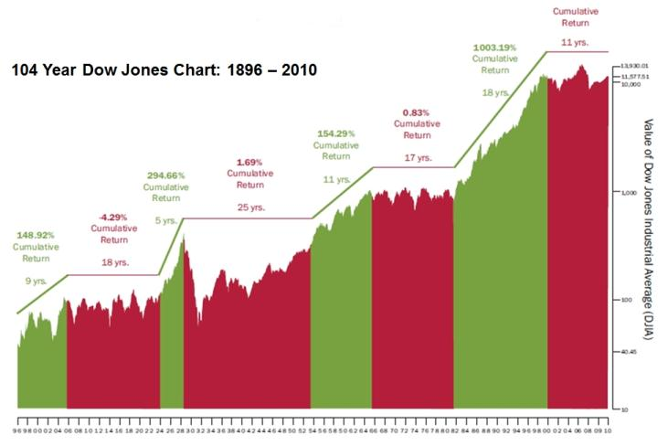
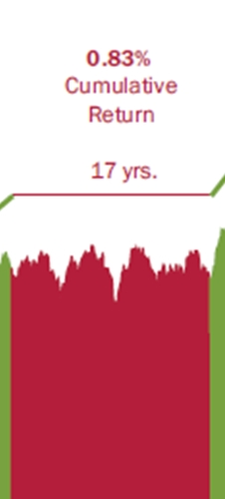
‘66 – ‘82
Chart courtesy of Rydex Investments www.rydexfunds.com
Notes:
This chart, provided by Rydex Investments, shows a long term perspective of the Dow Jones Industrial Average. It highlights the fact that markets move in cycles. Over the 114 year time frame, there have long periods of relatively flat to somewhat negative performance followed by periods of advancement.

Slide 10
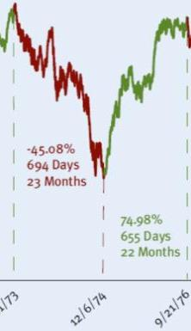
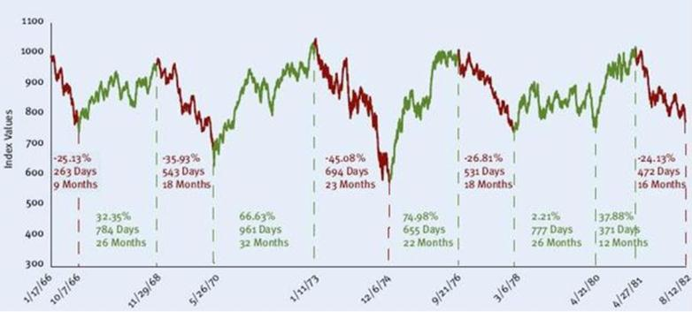
History Of Bear Markets: DJIA 1966-1982
- A Closer Look: ‘73 – ‘76
Chart courtesy of Rydex Investments www.rydexfunds.com
Notes:
This graph highlights the 16-year secular bear market from 1966 to 1982, which is not unlike the current secular bear market that began in the year 2000. Secular bear markets typically last for many years. The point is to show you that throughout the entire period there were periods of up, down and sideways behavior. Q3AM does not try to predict the market; we react to the market. Our signals tell us when the market trends change and indicate when to make investment changes.

Slide 11
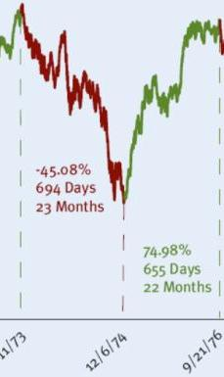
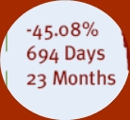
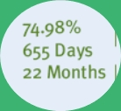
History Of Bear Markets: DJIA 1966-1982
- A Closer Look
Starting Balance
$100,000
$45,080
$54,920
$41,179
$96,099
Holding Period 45 Months:
Return = -3.90%
Chart courtesy of Rydex Investments www.rydexfunds.com
Notes:
Here’s an example of how a “Buy and Hold” strategy may have worked over a period that included a market downfall followed by a recovery rally.

Slide 12
The Case For Momentum Investing

Slide 13
The Case For Momentum Investing
Momentum is the tendency for investments to exhibit persistence in their relative performance
Investments that have performed well typically continue to do so, while investments that have performed poorly often continue to do so
Disciplined, systematic investment approach that can be applied across various asset classes
Notes:
What is momentum investing?
Q3 Asset Management’s dynamic asset allocation models all follow a momentum based methodology.

Slide 14
Investment
Strategies

Slide 15
Active
Management
Traditional
Asset Allocation
VS.
Active Approach
Buy-and-Hold
Disciplined Re-evaluation
Random Re-evaluation
Non-Correlation
High Correlation to Markets
Maintain the ability to perform in Bull & Bear markets
No Defensive Mechanism
Notes:
The difference between active management and traditional asset allocation.

Slide 16
The Programs
Dynamic Asset Allocation
Global ETF Allocation
Absolute Return Solution
Cipher
Notes:
We’re going to talk in more detail about two programs.

Slide 17
Global ETF
Invests in the top performing ETFs
Re-allocates on the first trading day of each month
Emphasis on Global Markets that exhibit the strongest relative strength
Adapts to unfavorable market conditions, that persist, by re-allocating to the top 3 ranked bond funds
Notes:
Global ETF Allocation uses a systematic approach that maintains the ability to adapt to changing market conditions. On the first trading day of each month, the program determines whether to overweight equities or bonds.
During favorable market conditions, the program invests in six top performing exchange traded funds. The program will maintain exposure to those global markets exhibiting the strongest relative strength. During unfavorable conditions, the strategy will allocate the portfolio to three top ranked bond funds. Global ETF Allocation is offered in conservative, moderate and growth risk profiles.
The program uses a market environment filter, which is described on the next slide, to determine favorable versus unfavorable market conditions.

Slide 18
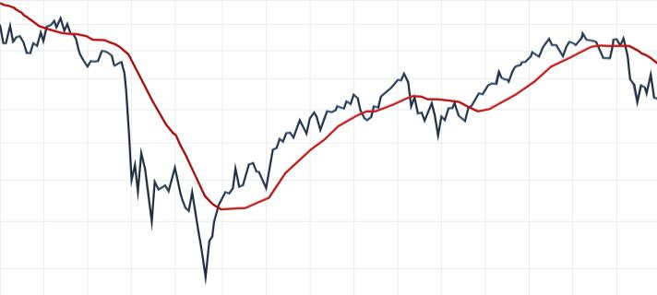
Offense or Defense – 75/25
January 1, 2008 – September 30, 2011
S&P 500
SMA (100)
2008
2009
2010
2011
Notes:
How does the Global ETF Allocation “market environment filter” determine if market conditions are favorable or unfavorable? It looks at the S&P 500 Index and the current value relative to its 100 day simple moving average. If the S&P 500 Index is above its 100 day simple moving average, this is considered a favorable market and the program will invest accordingly, respective of the programs risk profiles. If the S&P 500 Index is below its 100 day simple moving average, this is considered unfavorable and the program will move to bond ETFs.
It is expected that this program is invested in equity ETFs 75% of the time and, invested exclusively in fixed income ETFs 25% of the time.

Slide 19
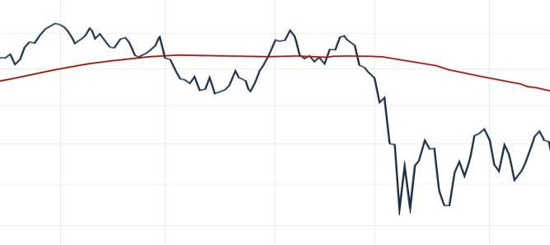
Sample Positions – Growth Model
S&P 500
SMA (100)
May
June
July
Aug
Sept
20+ Year Treasury (TLT) Investment Grade (AGG)
Treasury Protected (TIP)
Mid Cap Growth (IWP)
Small Cap Growth (IWO)
Mid Cap Growth (IWP)
Small Cap Growth (IWO)
Treasury Protected (TIP) 20+ Year Treasury (TLT)
Investment Grade (LQD)
Real Estate (VNQ)
Canada (EWC)
Commodities (DBC)
Australia (EWA)
Treasury Protected (TIP)
Investment Grade (LQD)
Mid Cap Growth (IWP)
Small Cap Growth (IWO)
Commodities (DBC)
Australia (EWA)
Russia (RSX)
Real Estate (VNQ)
Real Estate (VNQ)
Canada (EWC)
Notes:
This slide outlines the actual changes to the portfolio for several monthly re-allocations of the Global ETF Allocation Growth model. The green up arrows show the times when the S&P 500 was above its 100 day simple moving average on the day before the first of the month. On those trade days, the program invested in the top ranked ETF’s. The red down arrows provide examples of times when the indicator gave the signal for the model to go defensive, in these cases, allowing the model to shift to fixed income ETF’s.

Slide 20
Cipher – ^{(Data through 09-30-2011)}
Live Signals Began August of 2008
Trades NASDAQ 100 Mutual Funds – No Leverage
Invests in the market approximately 22% of the time,
while investing in the money market the remaining 78%.
Since inception, approximately 73% of the signals
have been profitable.
Prefers “Long” Trades (4 X 1)
Notes:
Cipher is an absolute return based strategy using signals that incorporate both price and volume analysis. Longer term analysis focuses upon identifying the primary trend of the market while shorter term methods focus upon counter-trend setups. On any given day, the program will be long, short, or in the safety of a money market fund. When a signal is generated, the program will move entirely into the desired position - there is no scaling into or out of positions.
What’s interesting about the Cipher model is that it’s in the market less than 25% of the time.

Slide 21
Sample Allocation
Diversify among strategies
React to changing markets
Offense and Defense
Notes:
Q3 Asset Management encourages investors to diversify among multiple strategies whenever possible.

Slide 22
Why Q3AM?
True Diversification
Rule Based Investing
Defined Exit Strategy
Calculated Investing + Defining Your Risk =
Opportunity for Success
Notes:
There are a number of reasons it might make sense to incorporate Q3AM’s tactical strategies into your portfolio.
A calculated, time-tested investment approach may provide you with more peace of mind in navigating today’s volatile markets.

